Slide 1

Lost & Found
Norhaziqah Binti Manap (2015057474)
Adriana Nadhirah Binti Ismail (2015057492)
Mohd Nur Hafiz Bin Mohd Mazlan (2015057483)
Ernest Nyelang (2015057501)

Slide 2


Index
Background and Significance
Design
Front Page
Search Page
File Upload
Delete Post
Database
Implementation

Slide 3
Background and Significance
Most organization have been using lost and found counter for each building or each floor.
However this system is not organized and complicated. This makes people to post the item in the Facebook or twitter which is harder to be found if they are not friends.
Therefore this web application system is created to solve this problem by helping an organization to make it even more systematic.
Other than that, people can directly contact the person who found it, which make it easier.

Slide 4
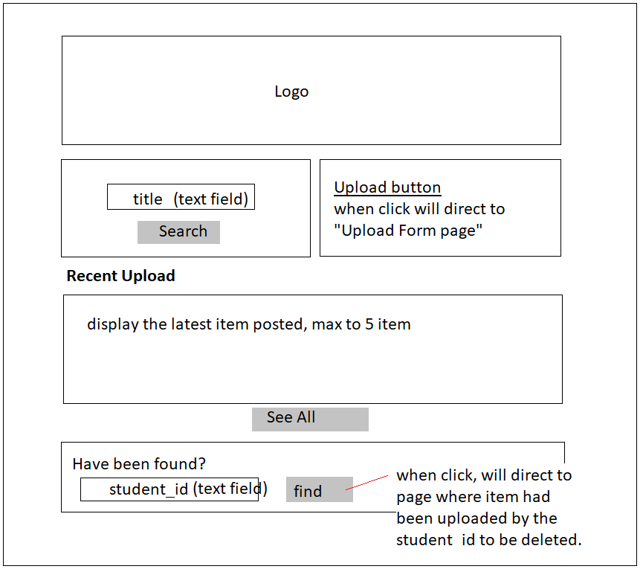
Design – Front Page
Input text field
is searched by title,
Will go to another
“search page”
Insert student id to
Obtain a list of item
has been uploaded by
the student_id in the
text field

Slide 5
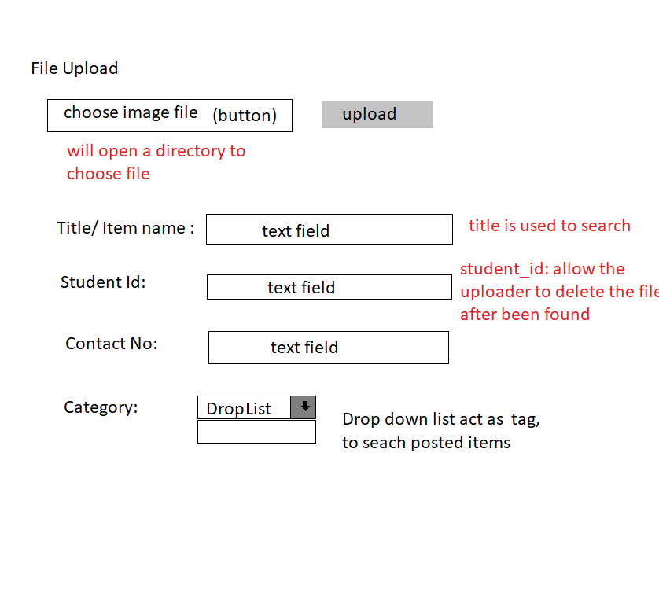
Design – File Upload
Upload image
of item
Form-like info
About the item
Using text field
By using drop down
list which act as tag,
Will make it easier
to categorize the item

Slide 6
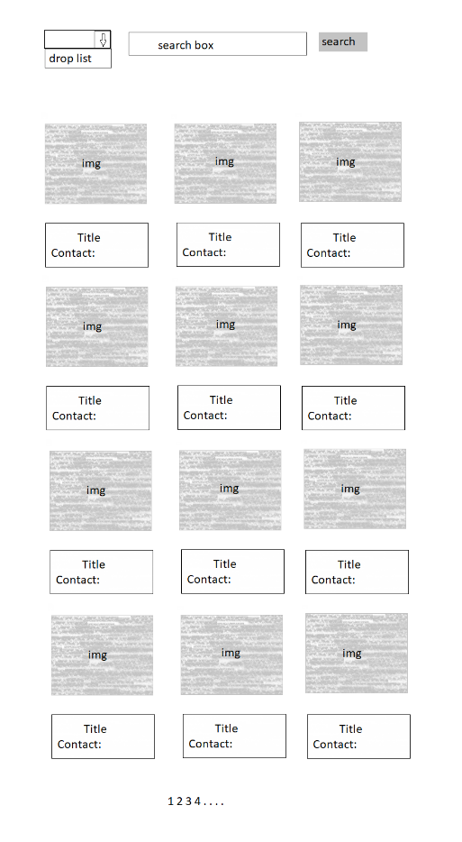
Design – Search Page
Find by category, the page will refresh
to show result based on category
Specific title, the page will
refresh to show the result
The search result is display 3 x 4 Which are 3 columns by 4 rows
The detail of each item is display, provided with the contact number of the people who found it.
Therefore, the item’s owner can directly contact the person

Slide 7
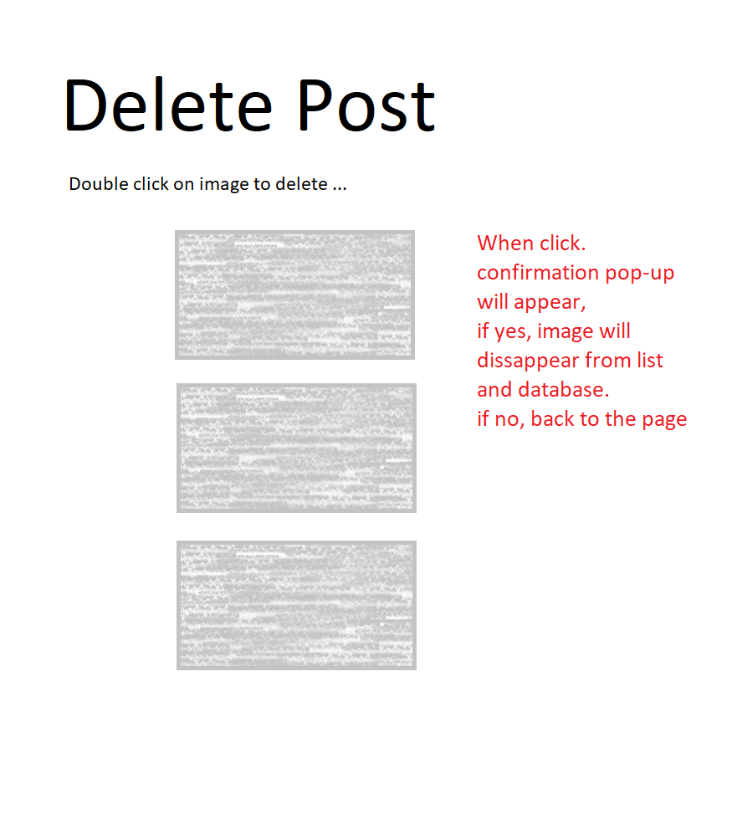
Design- Delete Post

Slide 8
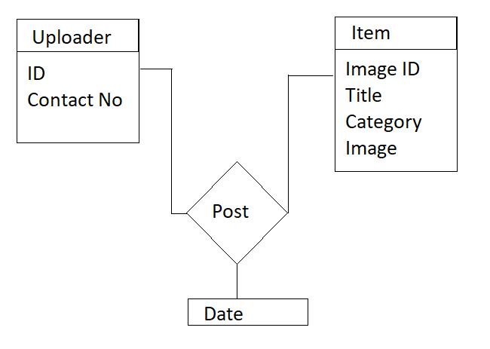
Database
Table name: Item
Image ID | Title | Category | Image
Table name: Uploader
ID | Contact No
Table name: Post
Image ID | Uploader ID | Date

Slide 9
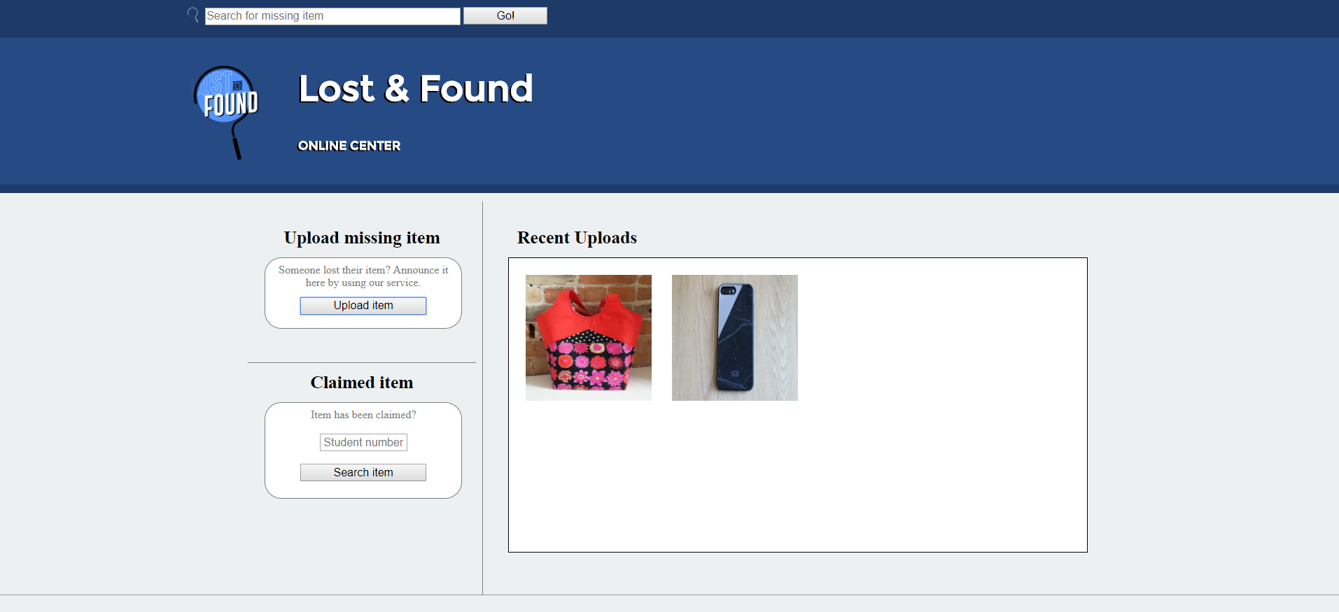
Implementation

Slide 10
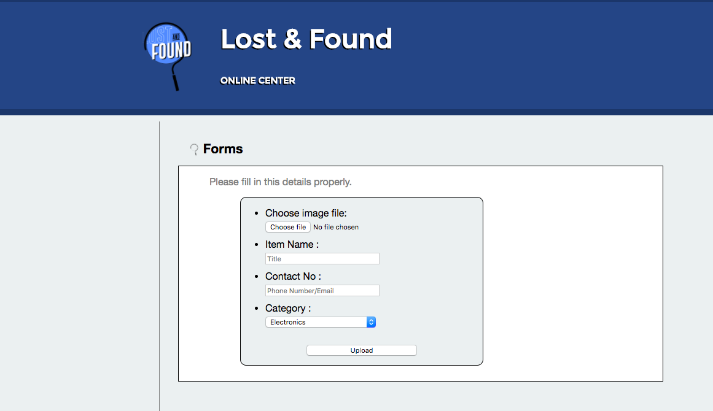

Slide 11
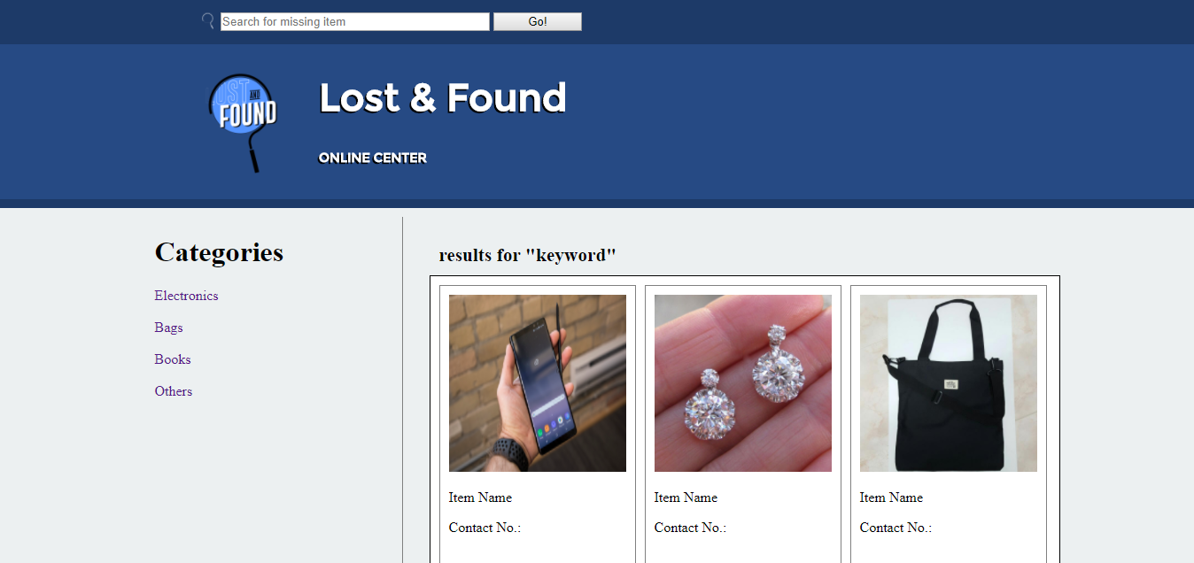

Slide 12
